Slide 1
Automating Low-Risk Entries in NinjaTrader 8 an overview of the R100x strategy
Disclaimer: This is informative/theoretical content and is not a recommendation to risk capital.
These videos are not targeted at beginners, they assume prior knowledge of trading, price action, software, etc.

Slide 2
Traders are the problem!!!

Slide 3
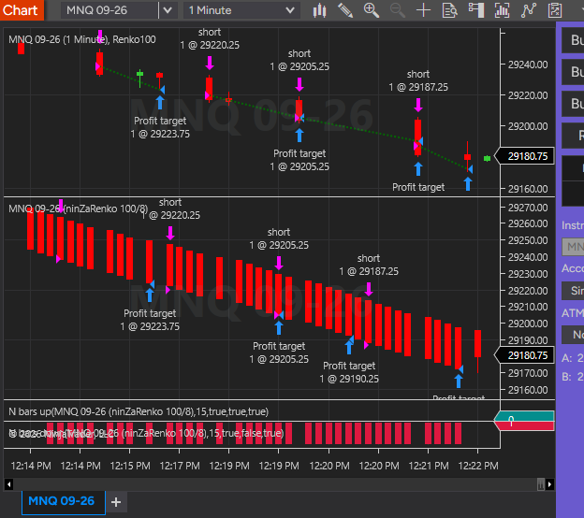
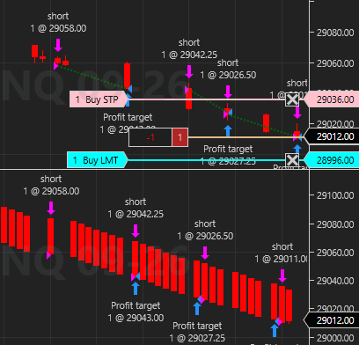
Did you catch this?

Slide 4
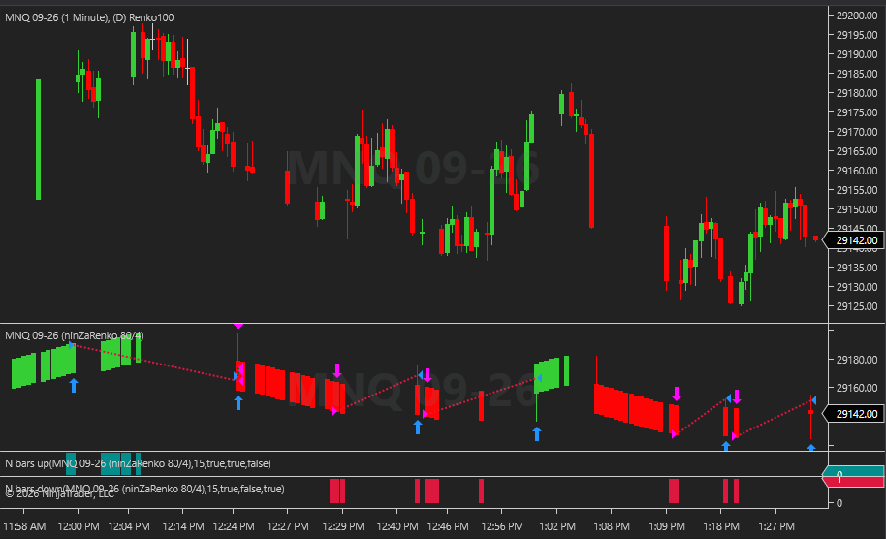

Slide 5
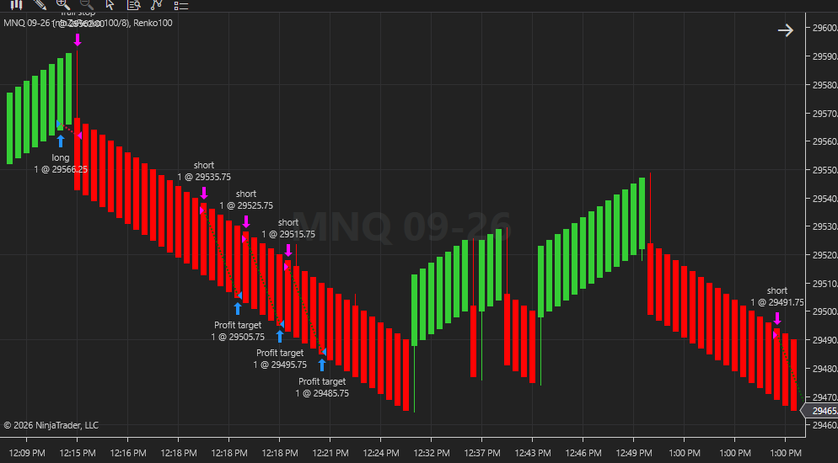
BACKTESTING – FORWARD TESTING – MARKET REPLAY

Slide 6

Plans for this channel moving forward
Strategy Tuning
Strategy Analyzer Backtesting
New Strategy development

Slide 7
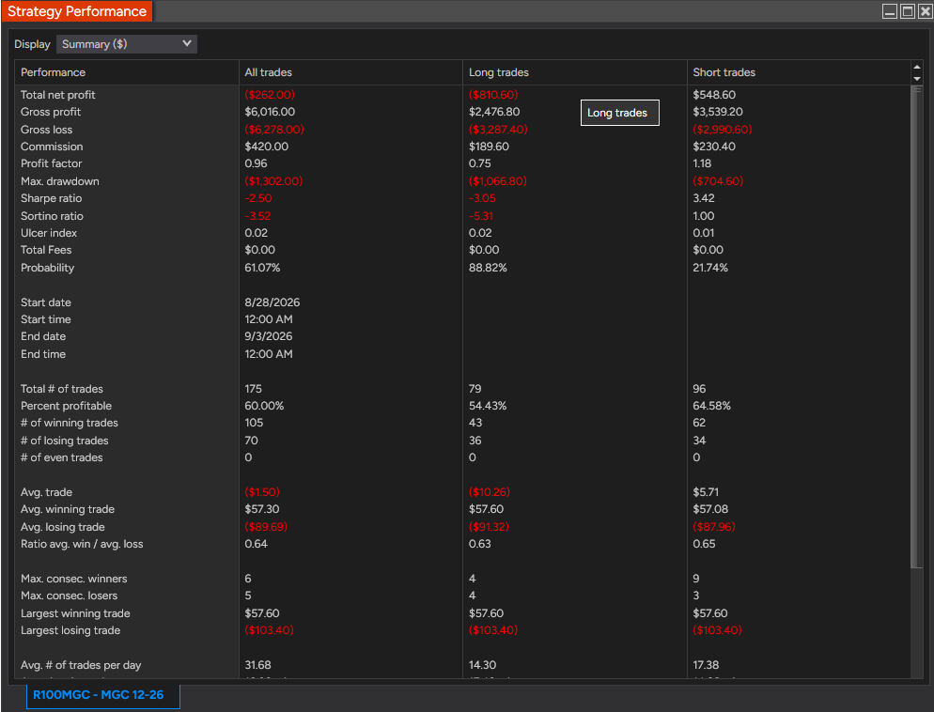

Slide 8
